Slide 1
Kelp I’m Pressed!
Examining algal evolution through art

Slide 2
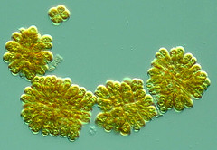
What are Algae?
This Photo by Unknown Author is licensed under CC BY-NC

Slide 3
Algae is a term that is used to describe photosynthetic protists
  These organisms are found in all environments
  Highly diverse but are simplistic in structure
Algae encompass six major phyla
  Chlorophyta (green algae), Rhodophyta (red algae), Glaucophyta, Euglenophyta (euglena), Chlorarachniophyta, and Chromophyta (heterokonts, haptophytes, cryptomonads, and dinoflagellates)

Slide 4
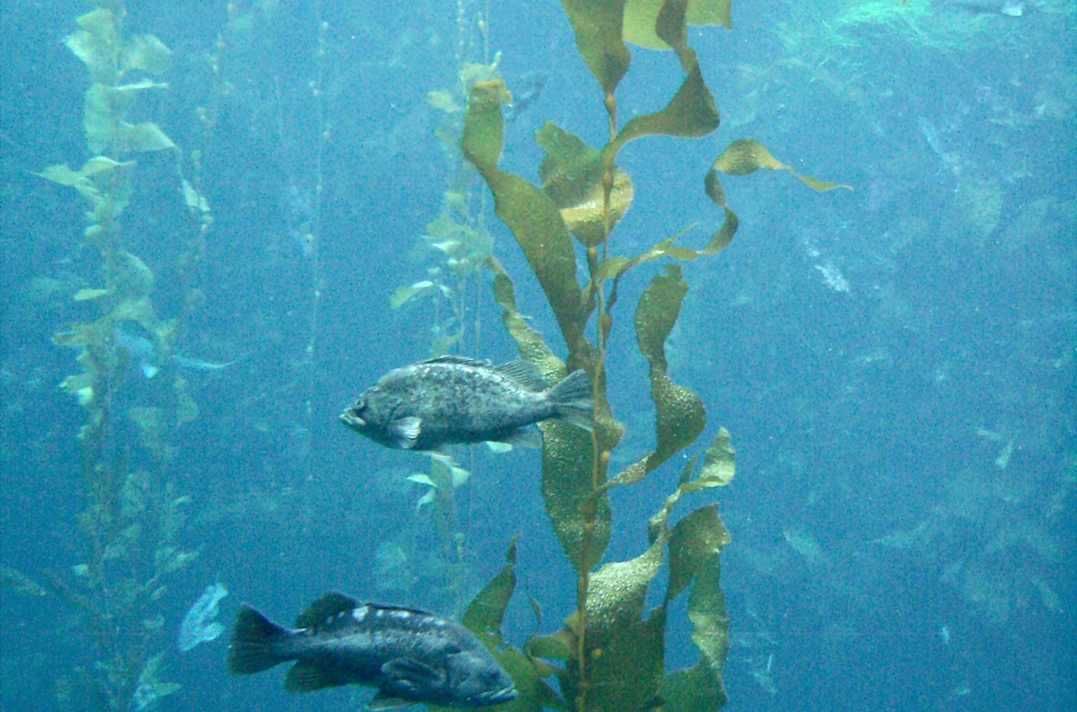
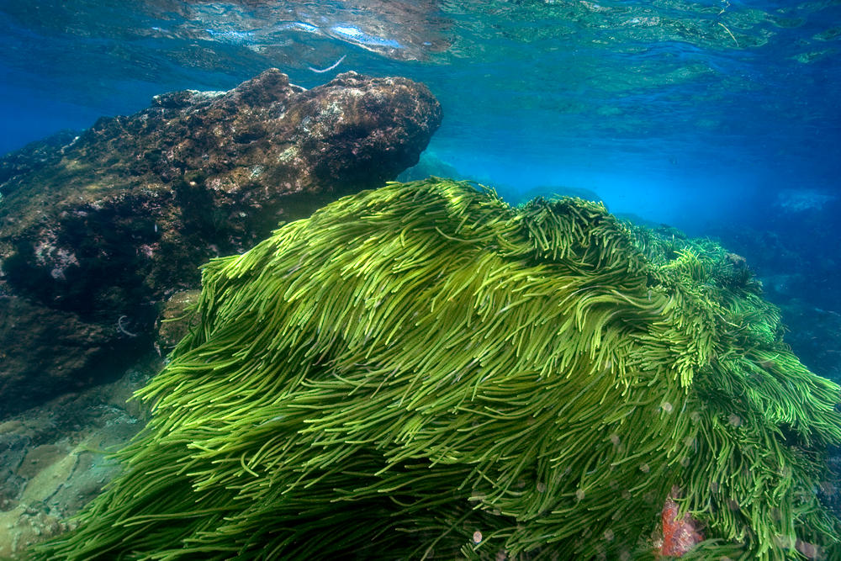
Macroalgae
Macroalgae is a term that encompasses the organisms that are visible to the human eye
They lack true leaves, roots, stem, and flowers
What are some examples of macroalgae?
This Photo by Unknown Author is licensed under CC BY-SA
This Photo by Unknown Author is licensed under CC BY-SA

Slide 5
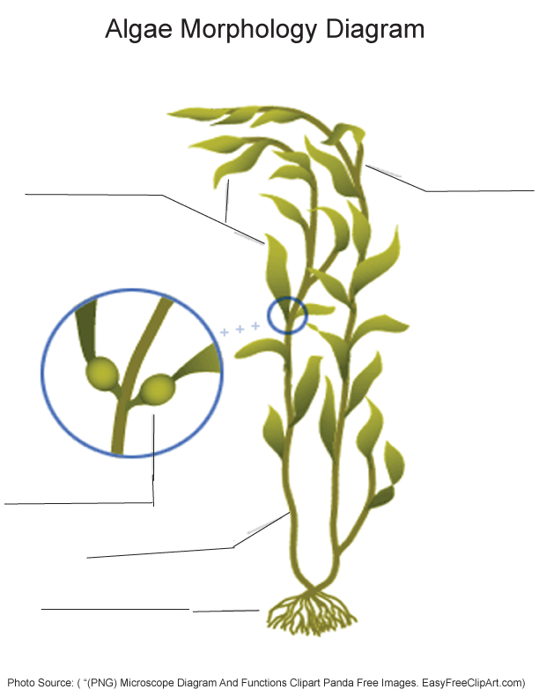
What are the following features?
  Blades (leaf-like structure)
  Frond (whole structure)
  Gas Bladder
  Stipe (stem-like structure)
  Holdfast (root-like structure)

Slide 6
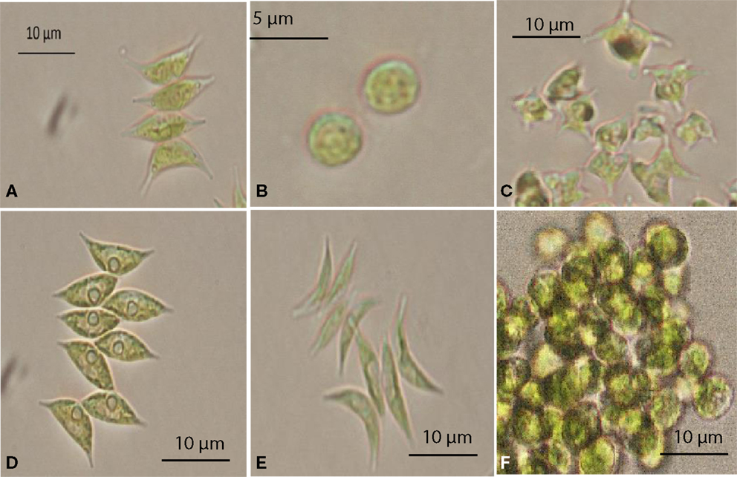
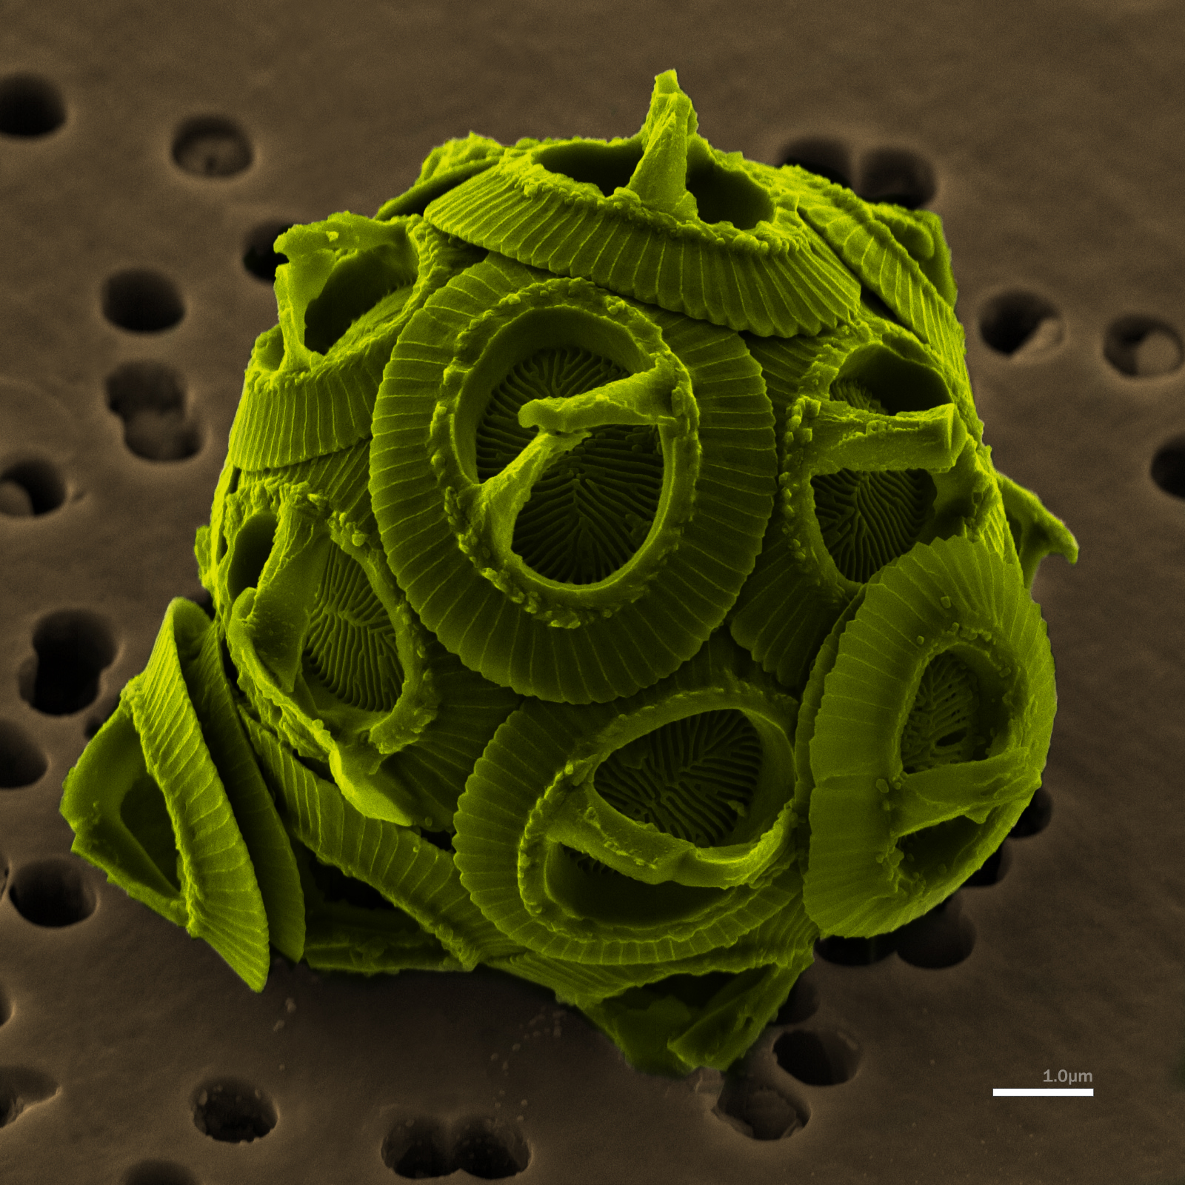
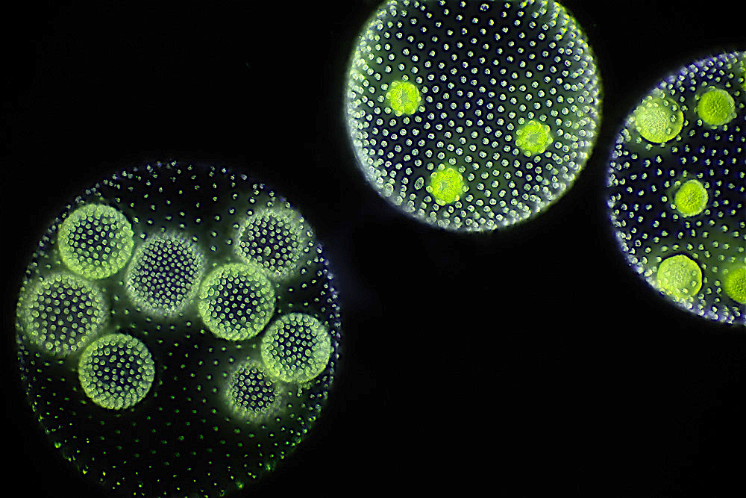
Microalgae
Term used to describe algae that are not visible without the use of a microscope
Some microalgae possess a silica wall while others contain chlorophylls and xanthophylls
This Photo by Unknown Author is licensed under CC BY
This Photo by Unknown Author is licensed under CC BY-SA
This Photo by Unknown Author is licensed under CC BY-SA

Slide 7
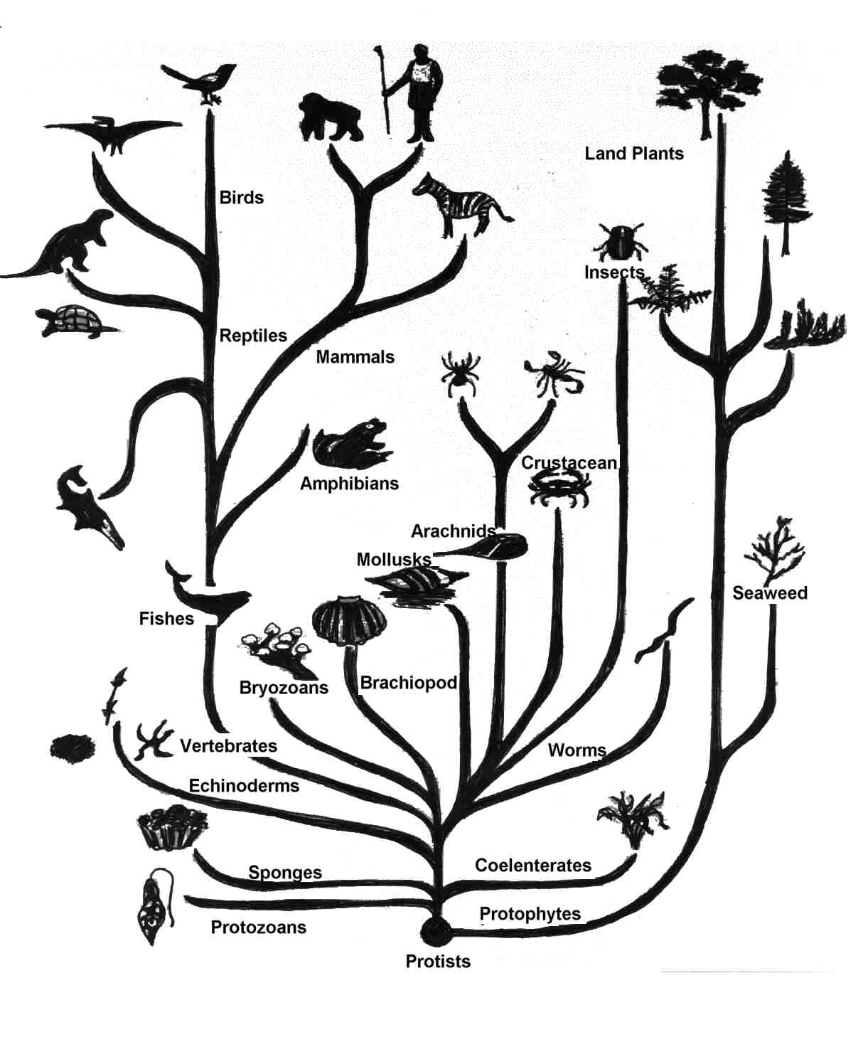
What is Evolution?
This Photo by Unknown Author is licensed under CC BY-NC

Slide 8
Evolution is defined as a heritable change in one or more characteristics of a population from one generation to the next. This process not only changes the morphologies and characteristics within populations but has the ability to create new species.

Slide 9
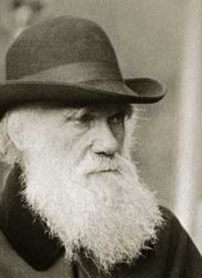
Charles Darwin
In 1859 Darwin published a book entitled The Origin of Species which backed his theory: that all existing species have evolved from pre-existing ones.
Name some of Darwin’s observations that support the theory of evolution
This Photo by Unknown Author is licensed under CC BY-NC-ND

Slide 10
Algal Evolutionary History
Algae have evolved through a process known as endosymbiosis
  Three different processes
    Primary endosymbiosis – heterotrophic eukaryotic cell engulfs a photosynthetic cyanobacterium
      Produces: Chlorophyta, Rhodophyta, and Glaucophyta
    Secondary endosymbiosis – heterotrophic eukaryotic cell engulfs red algal cell
      Produces: diatoms, kelps, euglenoids, cryptomonads, haptophytes, chlorarachniophytes, and some dinoflagellates
    Tertiary endosymbiosis – dinoflagellate engulfs a cell produced by secondary endosymbiosis
      Produces other dinoflagellates

Slide 11
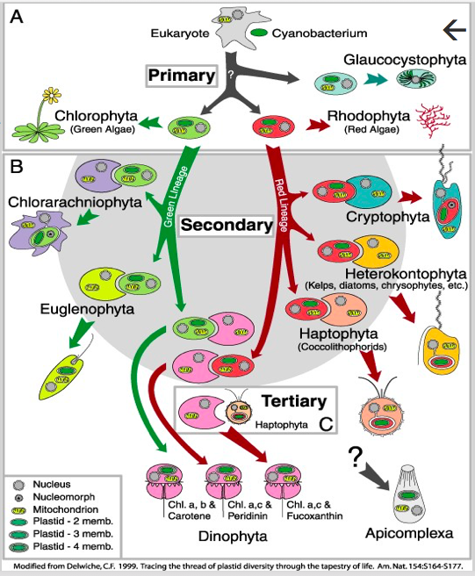
This Photo by Unknown Author is licensed under CC BY-NC-ND

Slide 12
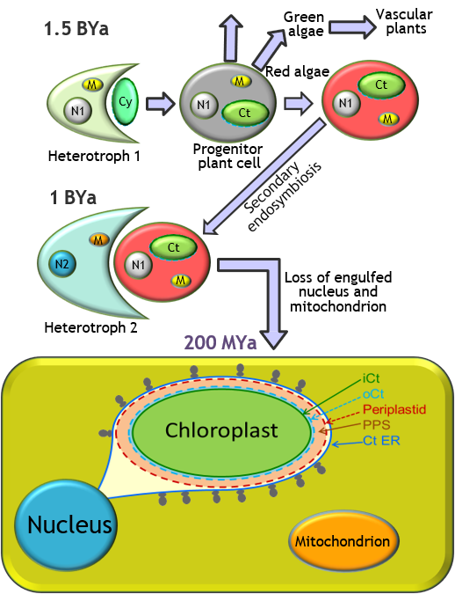
What is being depicted by this figure?
How do we know that the cell from 200 million years ago is a diatom?
This Photo by Dr. Sarah Ruffell is licensed under CC BY-NC-ND

Slide 13
Algal Evolution and Art
Examining the work of Ernst Haeckel

Slide 14
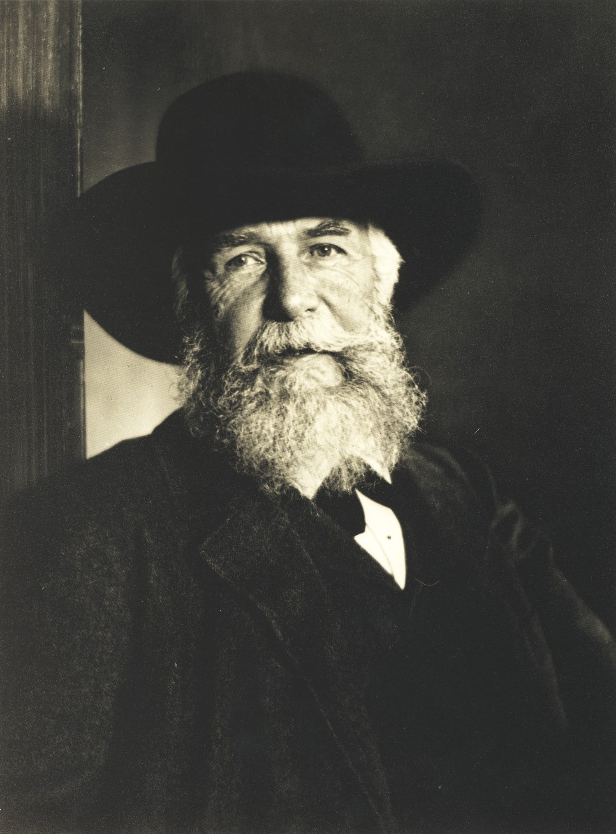
Ernst Haeckel
Published a book entitled Art Forms in Nature
Inspired by Darwin’s Origin of Species
Bridged the gap between art and science
This Photo by Unknown Author is licensed under CC BY-SA

Slide 15
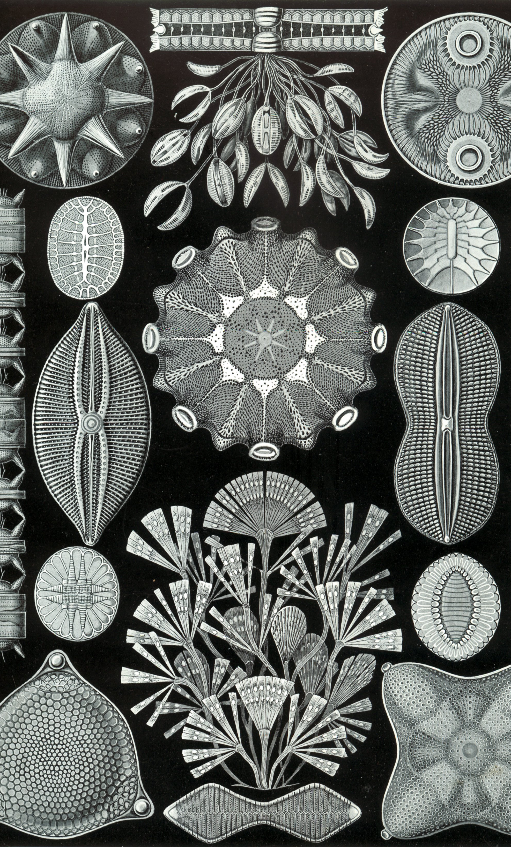
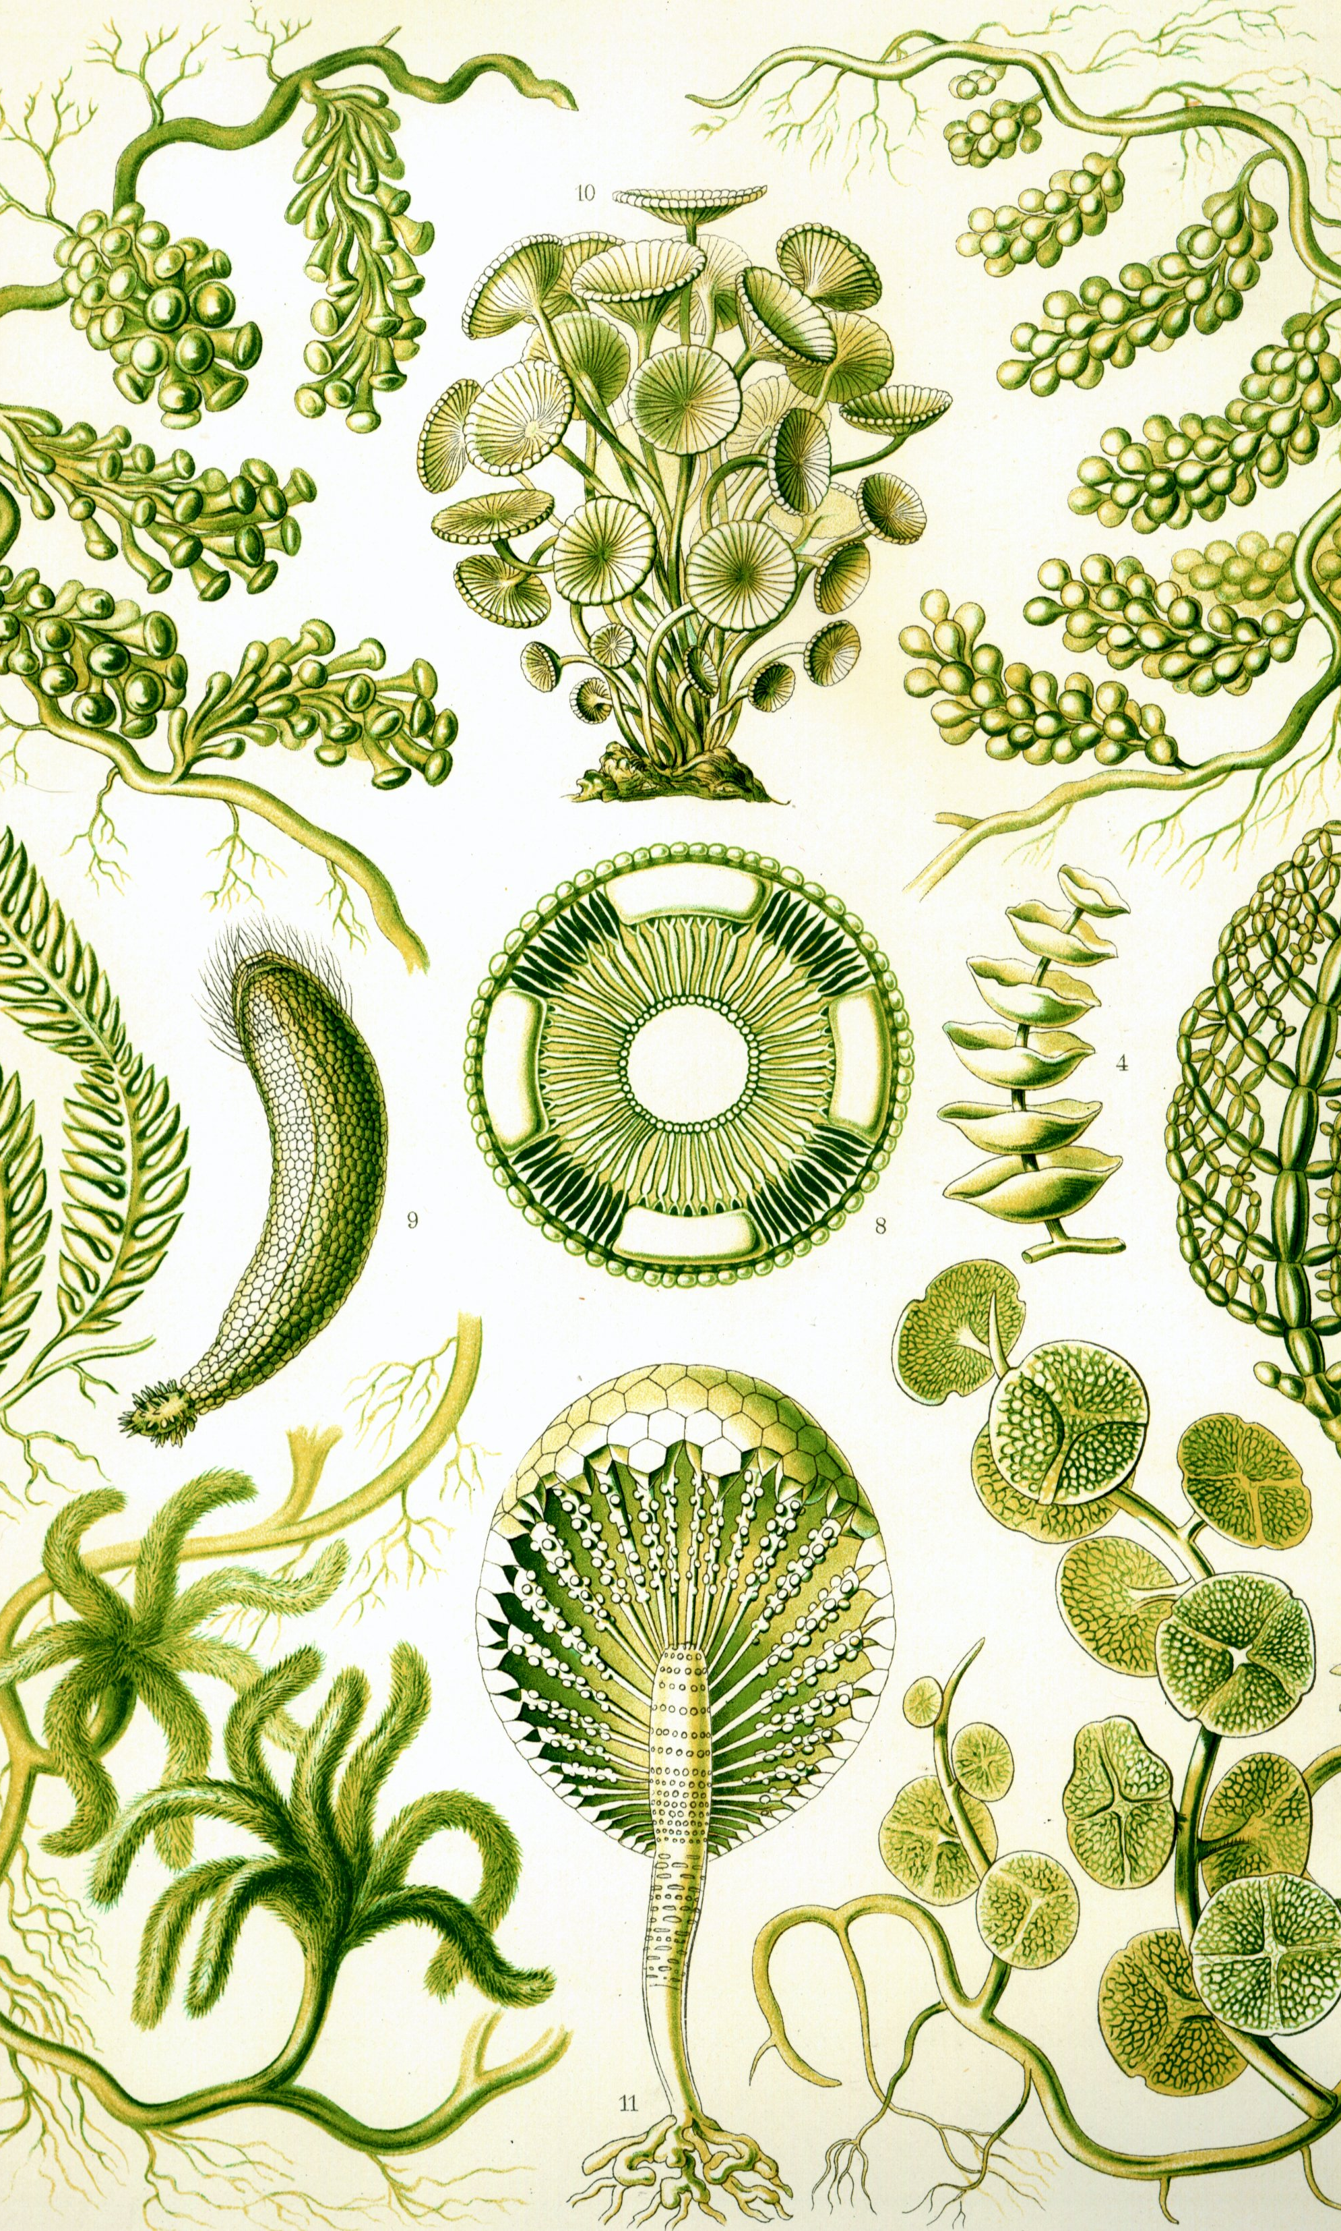
How do Haeckel’s green algae and diatom prints explain algal evolution?
What are the similarities and differences between these prints?
This Photo by Unknown Author is licensed under CC BY-SA
This Photo by Unknown Author is licensed under CC BY-SA

Slide 16
References

